Slide 1
Recommendation
Hsiang-Hsuan Hung (HHH)
Hsiang.Hung2015@gmail.com

Slide 2



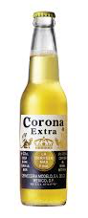


Why Do We Need Recommendation?
I like Budweiser!!!
, , ….
> 3000 products
Enhance customers’ satisfaction, so more purchase

Slide 3
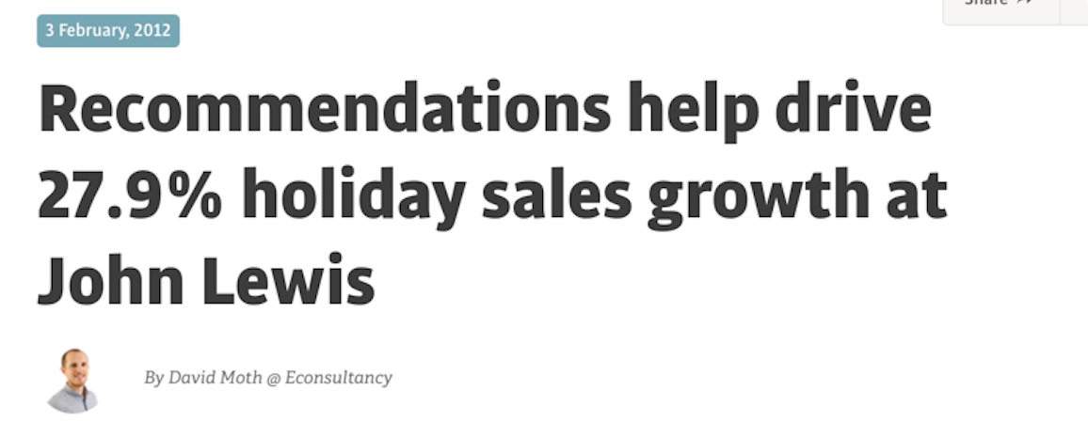
Why Do We Need Recommendation?
Always give good recommendation
Understand customers’ demographic characteristics

Slide 4


I rate for !
but for !
Rating = ? ?

Slide 5

I rate for !
but for !
recommend
pred = 4.3
pred = 1.7

Slide 6

Personalized Recommendation
Different people have different tastes, so rating.
5
4.5
3
1
1.5
1
3.5
5

Slide 7
Personalized Recommendation
Supervised learning, regression problem.
Central concept: Similarity
a.) item-item recommendation (Amazon)
b.) user-item recommendation
Content-based filtering (Pandora)
Collaborative filtering (Netflix, Spotify)

Slide 8
Item-Item recommendation

Slide 9
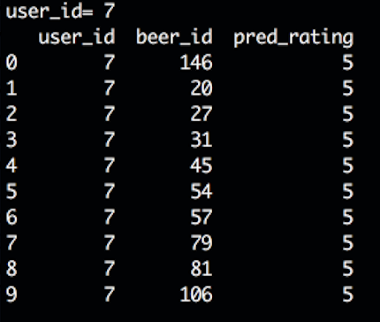
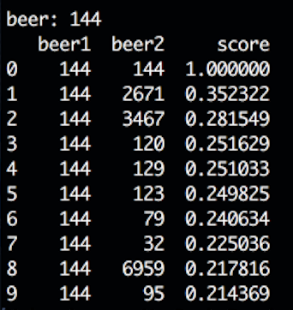
Recommendation Engine UI
When Simpsons (id=7) is browsing #144 beer:

Slide 10
Recommendation Engine UI
When Simpsons (id=7) is browsing #144 beer:
item-item reco

Slide 11
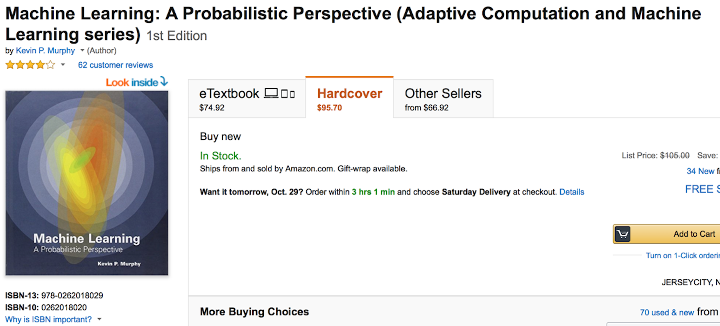
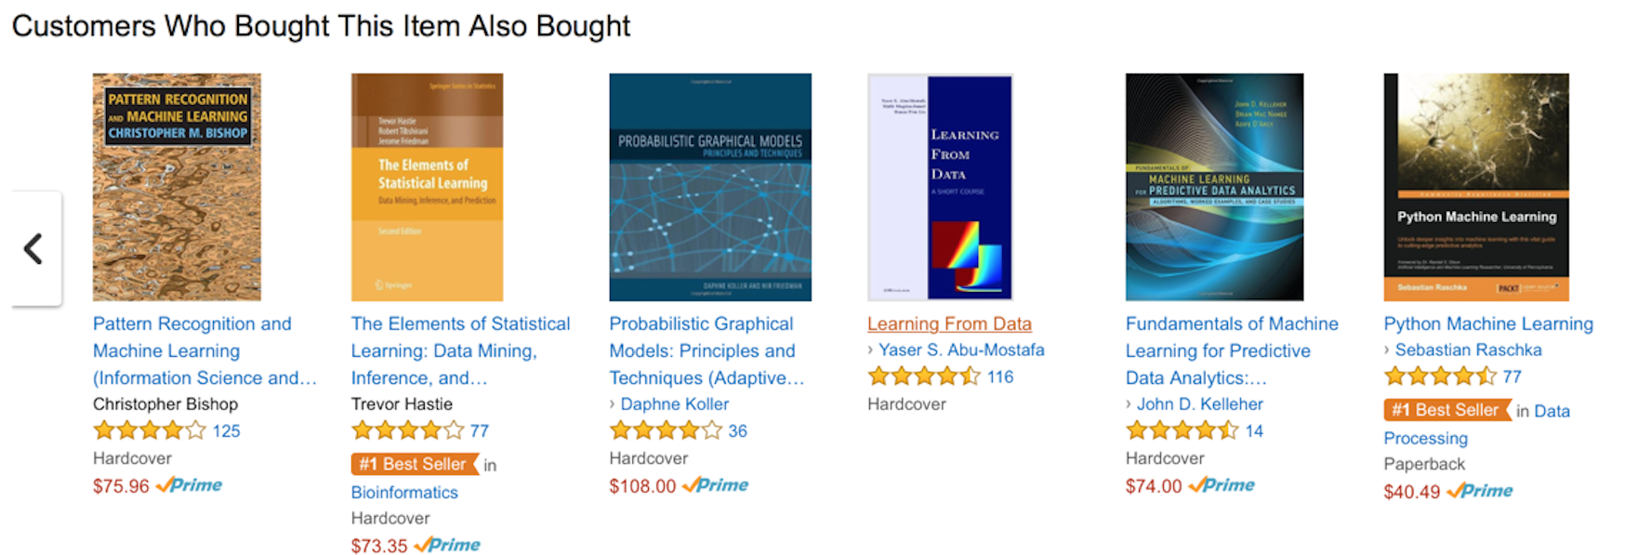

Slide 12

Data Source: BeHoppy (SQL)

Slide 13
The Beer Content Data

Slide 14
Beer id
The Beer Content Data
Beer vectors are represented by features:

Slide 15
Beer Vector Space

Slide 16
Cosine Similarity
is more similar
to than

Slide 17
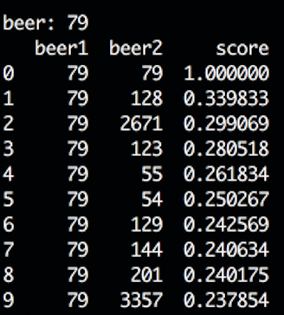
Cosine Similarity
is more similar
to than

Slide 18
Recommendation Engine UI
When Simpsons (id=7) is browsing the beer page:
user-item reco

Slide 19
User-Item recommendation

Slide 20
Content-Based Filtering
Content-based reco systems, Pazzani1and and Billsus
Simpsons
customers’ ratings:

Slide 21
Content-Based Filtering
Content-based reco systems, Pazzani1and and Billsus
Simpsons
HHH
customers’ ratings:

Slide 22

Content-Based Filtering
Each user is a regression problem:

Slide 23
Content-Based Filtering
Each user is a regression problem:
Predict

Slide 24
Cold Start: Spare Rating Data
number of users: 1728
number of beers: 1854
number of ratings: 12360
sparsity = 0.9962%
D: For most users, little data points, low accuracy:

Slide 25
Collaborative Filtering (CF)
No content features are needed.
Consider user-item interactions
beers
rating table
5 6 7 8 9 10 11
5 4 1 5 5 4
7
33
1
34
1 2 5 1 2 2
users
42
45
3 5 2 5 5 4
47
4
4
48
4

Slide 26
Collaborative Filtering (CF)
No content features are needed.
Consider user-item interactions
Neighborhood model
– item based (use item similarity)
– user based (use user similarity)
Latent-factor-model

Slide 27

Vector Space by Beer Rating Vectors
beers
..7
8
9
10
11 ..
7
33
34
users
beer similarity:
42
45
47
48

Slide 28
Neighborhood Model – Item Based
Sarwar, Karypis, Konstan, and Riedl , (2001)

Slide 29
Neighborhood Model – Item Based
Sarwar, Karypis, Konstan, and Riedl , (2001)
k-nearest-neighbor:

Slide 30
Neighborhood Model – Item Based
Sarwar, Karypis, Konstan, and Riedl , (2001)
Model = kNN + weight:
similarity as weight

Slide 31


Vector Space by User Rating Vectors
beers
5
6
7
8
9
10
11
12
7
33
34
users
42
45
user similarity:

Slide 32
Neighborhood Model – User Based
Herlocker, Konstan, Borches and Riedl , (1999)
Find similar users:
weight

Slide 33
Metrics
mean absolute error:
a) item-based:
Sarwar, Karypis, Konstan, and Riedl , (2001)
beer content and ratings as features
b) user-based:
c) Baseline:

Slide 34
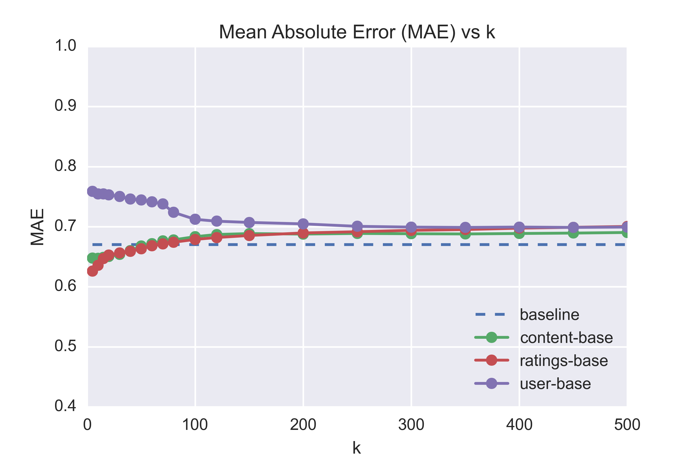
Model Performance
k=10-20

Slide 35
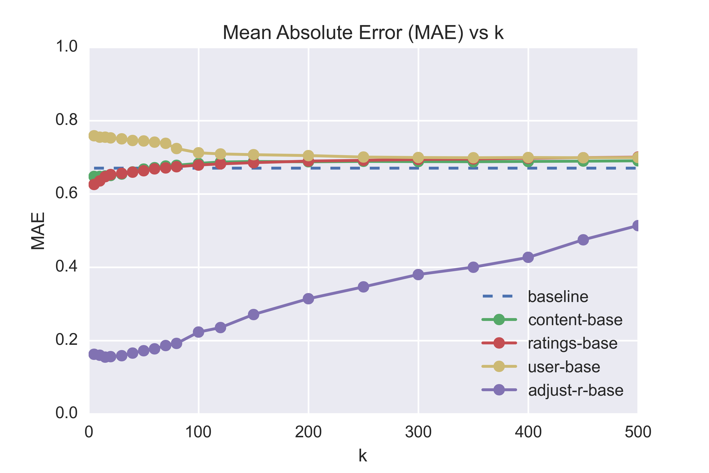
Revised Neighborhood - Adjusted Ratings

Slide 36
Disadvantages of the Model
NOT scalable.
Not easy to incorporate additional information, e.g. purchase, browse history (implicit data).
Alternative: latent-factor model!

Slide 37
Vector Spaces

Slide 38
Customer-Beer Vector Space
f: # of latent factors

Slide 39
Matrix-Factorization for Latent-Factor Model
Computer (2009), Koren, Bell and Volinsky
n beers
f
5 6 7 8 9 10 11
n
5 4 1 5 5 4
7
33
( )
34
( )
1 2 5 1 2 2
( )
42
f
m users
m
3 5 2 5 5 4
45
47
4
4
beer features
48
4
rating matrix
user preference

Slide 40
Matrix-Factorization Linear Regression
bias
user-item interaction
regularization
SVD, not scalable
Gradient descent, not convex problem
Alternating least square (ALS)!

Slide 41
What is the ALS?
Rating
matrix
( )
( )
( )
At each step, fix one variable, and solve minimization:
fix , solve fix , solve fix , solve

Slide 42
More Detail: Normal Equations
Hu, Koren and Volinsky, 2008
5 6 7 8 9 10 11
7
33
34
42
45
47
48

Slide 43
More Detail: Normal Equations
Hu, Koren and Volinsky, 2008
5 6 7 8 9 10 11
7
33
34
42
45
47
48

Slide 44
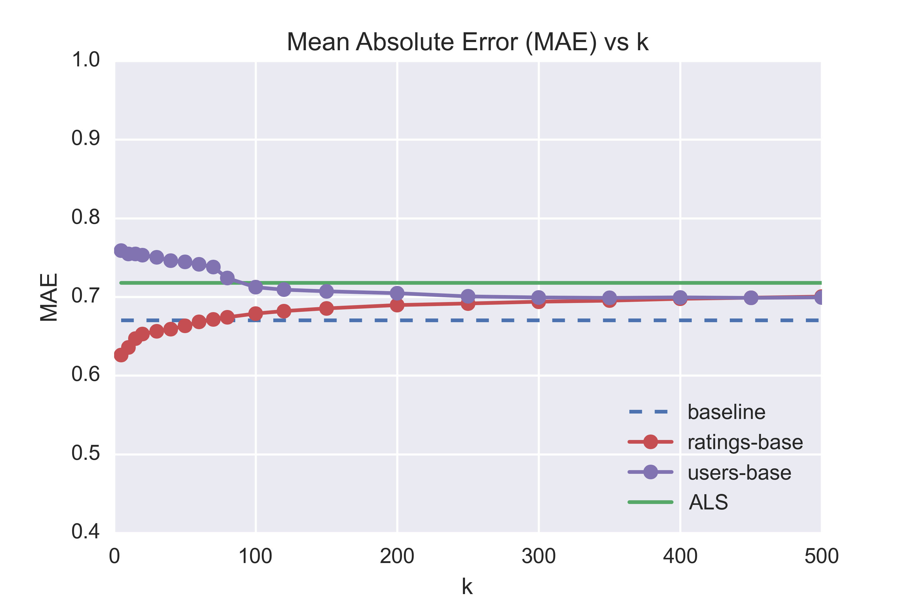
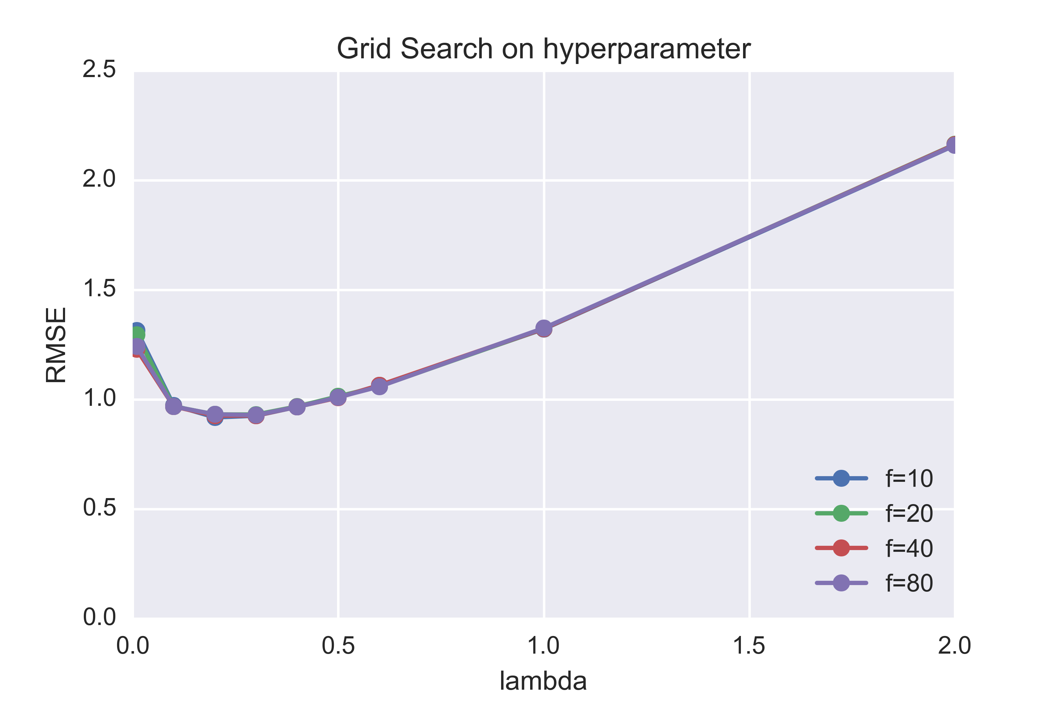
ALS Model Performance (on Spark)

Slide 45
Implicit Data: e-Commerce Data
Explicit feedback
(beHoppy)
ratings
Implicit feedback
(data warehouse)
purchase frequency
Hu, Koren and Volinsky, 2008

Slide 46
CF Using Implicit Data
Logistic regression + confidence weight
Hu, Koren and Volinsky, 2008
confidence
bias
user-item interaction
regularization
preference

Slide 47
Implicit Data CF Performance
Metric: percentile-ranking
Random:
Baseline:
CF:

Slide 48






Recommender Pipeline
rating data
e-commerce data
browse
web server
reco
Hybrid recommender

